Slide 1
Data Analytic Techniques Using Elasticsearch, Hadoop, Kibana and Amazon Web Services
Director
Dr. George Hsieh
Presented by
Likhita Sanapa Prabhakar

Slide 2
OUTLINE
Introduction
Elasticsearch Using Hadoop
Elasticsearch Using AWS
Conclusion
Future Work

Slide 3
Introduction
Data Analysis and Management is an increasingly important process in today’s business world, to gain insights and competitive advantages. There are many tools used for analyzing and managing logs.
Elasticsearch is one such powerful distributed search and analytics engine developed in Java and built on top of Lucene. It is a free and open source search engine which can perform full-text search.
Kibana is an open source visualization tool, often used along with Elasticsearch, to create visualizations from the indexed data on Elasticsearch cluster and provide useful insights especially from large volumes of data.

Slide 4
.
Apache Hadoop is commonly used with Elasticsearch for immense data storage and huge processing power.
For public cloud based computing environments, Amazon Web Services (AWS) is a very popular platform providing Elasticsearch and Kibana capabilities.
This Master’s Project research was focused on analyzing and managing data using Elasticsearch, Kibana, Hadoop, and AWS.
The goal of this project is to learn and experiment on how data analysis works.

Slide 5
Elasticsearch Using Hadoop
The first process is to setup a CentOS 7 machine, install all the necessary tools for performing analysis using Elasticsearch Hadoop.
we implemented a (pseudo-distributed-mode) Hadoop cluster, configured with Elasticsearch and Kibana using the ES-Hadoop library, on a local Linux workstation.
This process explains how to use Elasticsearch and Hadoop locally, analyze data from the input provided, index the data and visualize it. It shows the interaction between Elasticsearch and Hadoop tools.
Setting up environment (Java, Dedicated user, Hadoop, Elasticsearch, Start Hadoop Daemons).

Slide 6
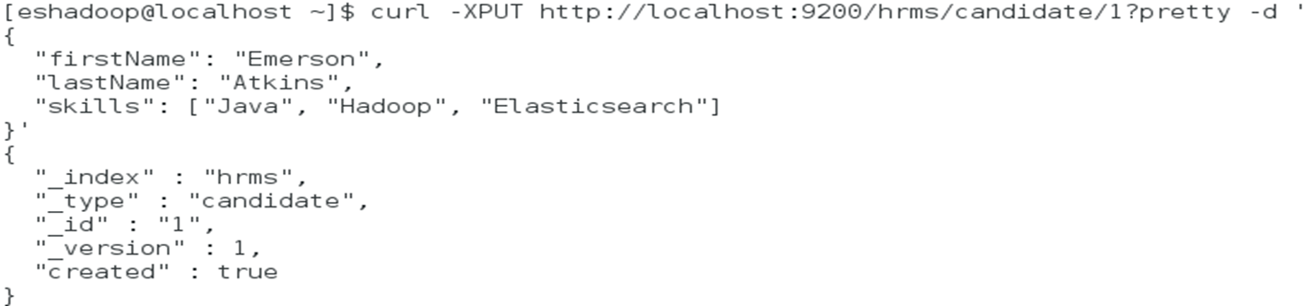
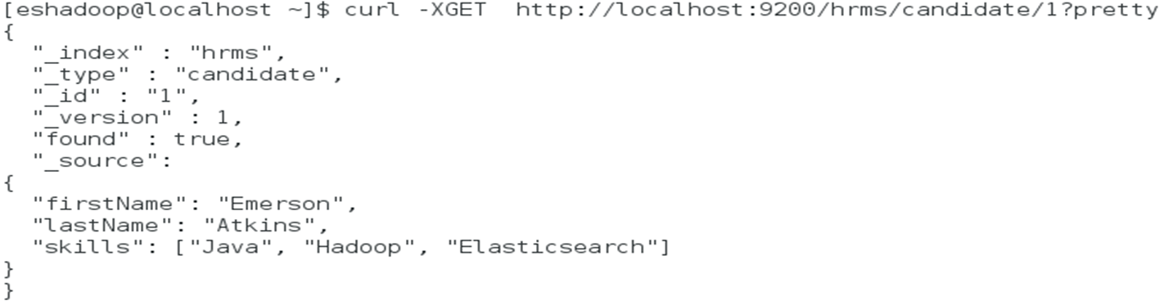
.
Elasticsearch.
CRUD.

Slide 7
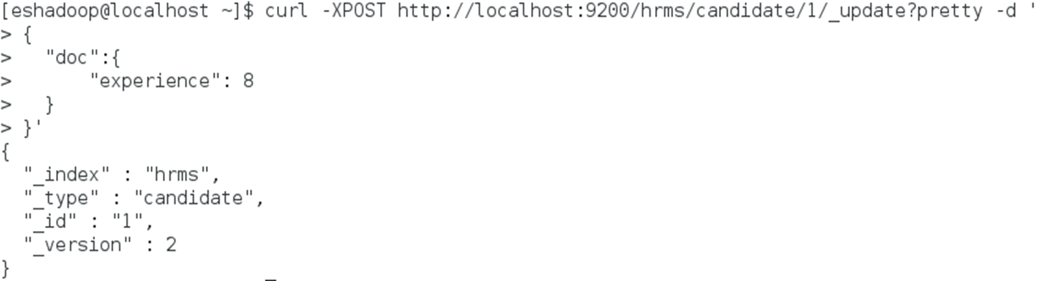
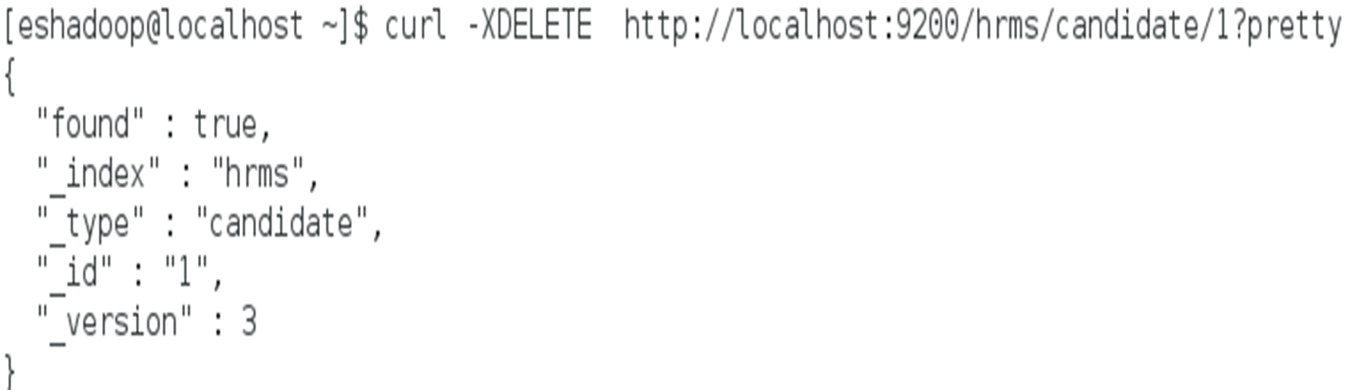
.

Slide 8
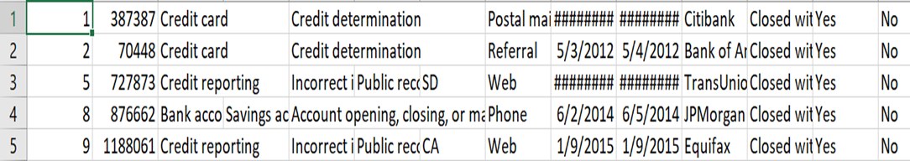
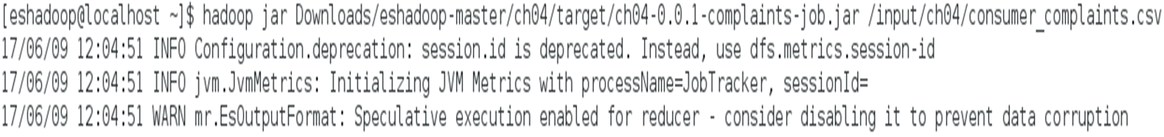
.
Consumer Complaints.
We use the below command to insert the data into HDFS.
$ hadoop fs –put consumer_complaints.csv /input/ch04/consumer_complaints.csv
Here a job jar file is generated and the consumer complaints data is loaded into HDFS.
$ mvn clean package

Slide 9
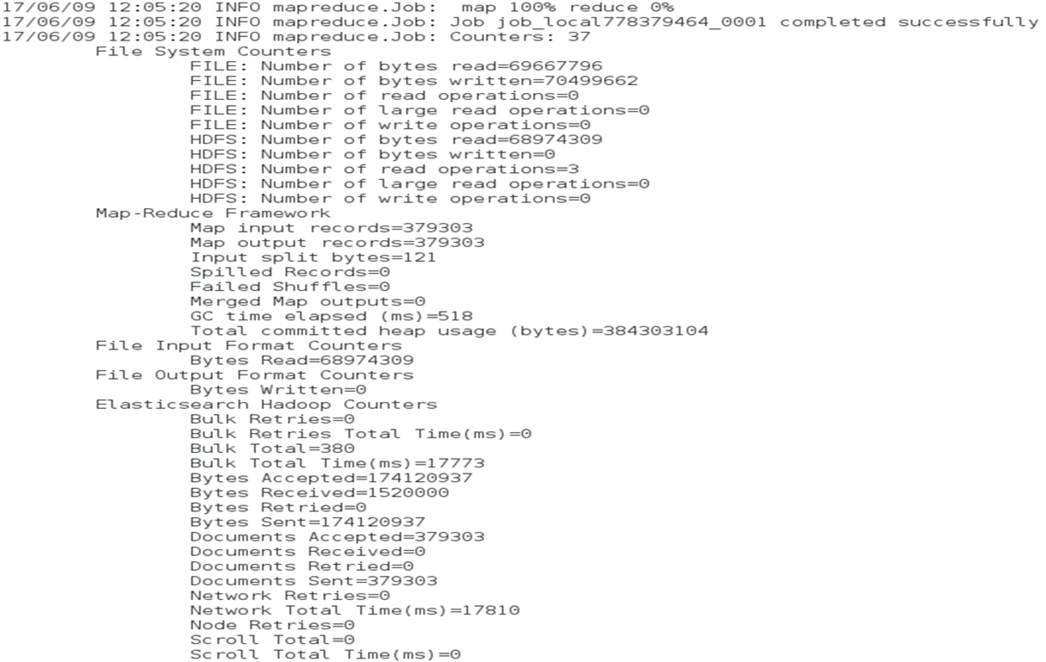
.
We then run the Jar file on the sample data which is in HDFS. This executes the Hadoop MapReduce job and imports the data to Elasticsearch. The Mapper class counts each word and the Reducer class sums all these counts for each word. The output shows the log details that indicate the advancement in job execution.

Slide 10
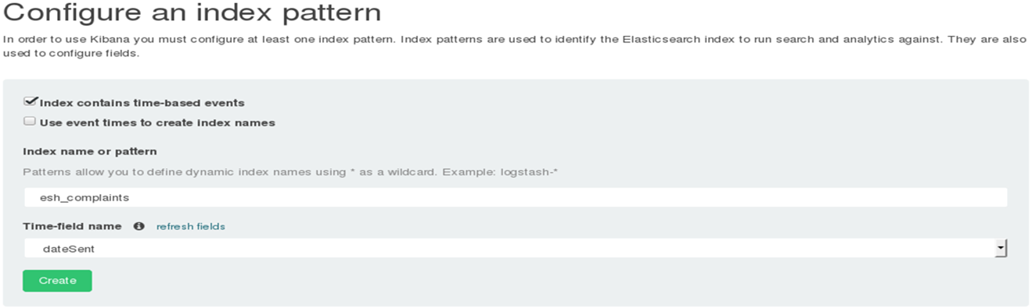
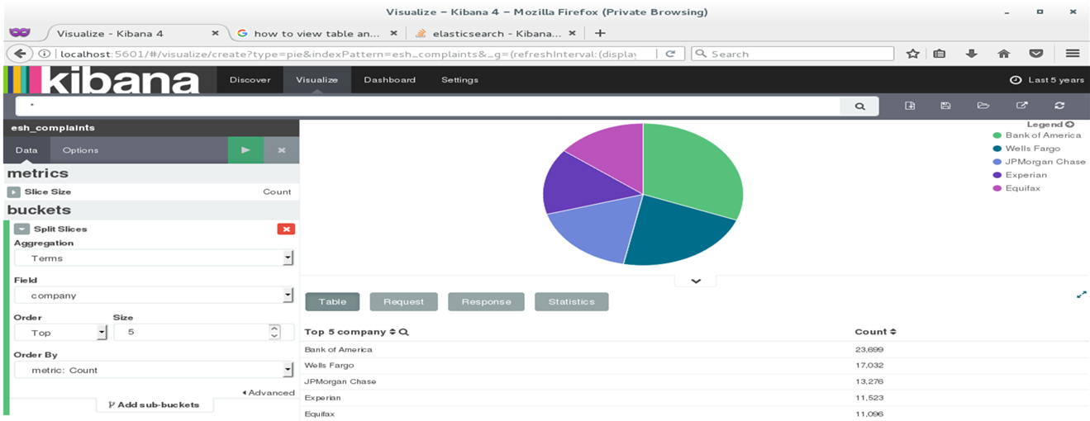
.
Kibana.

Slide 11
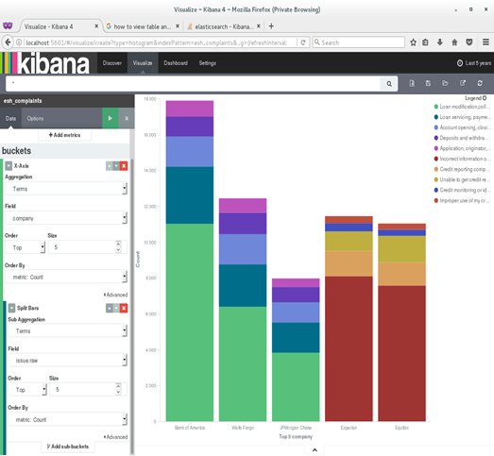
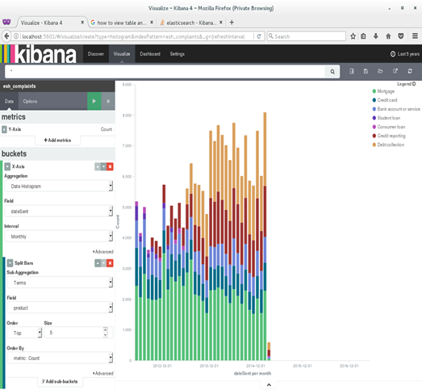
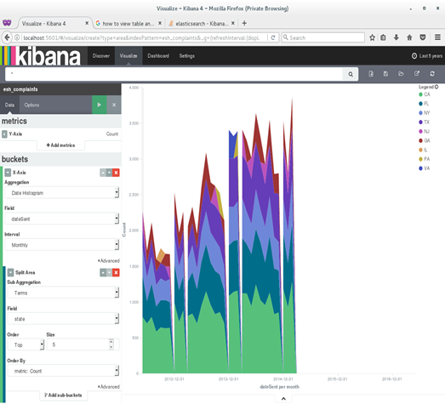
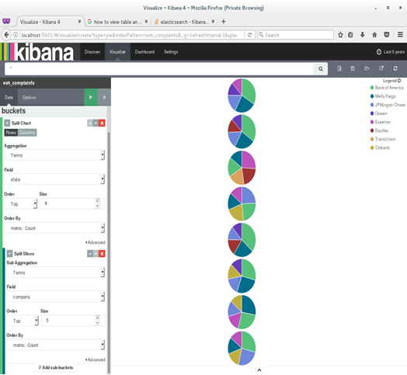
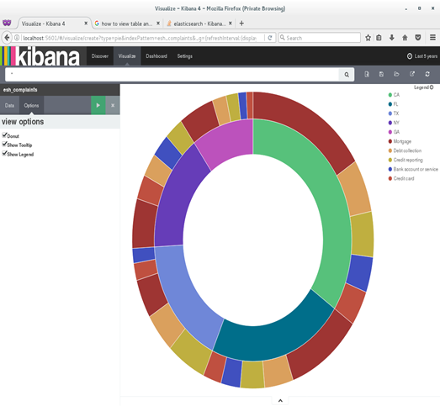

.
.

Slide 12
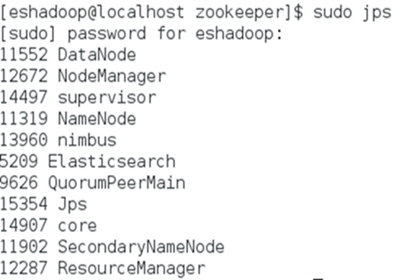
.
Real-Time analytics.
Apache Storm is used to import and stream the Twitter feed in Elasticsearch.
Apache Storm uses Spouts and Bolts as a topology to collect and parse the twitter streams.
Spout is a medium of streams in a topology. It collects tuples from multiple data sources and puts it in the topology.
Bolts does all the processing in the topology like filter, aggregate, join, etc. Stream transformations are done by bolts.
Start the Hadoop Daemons.

Slide 13
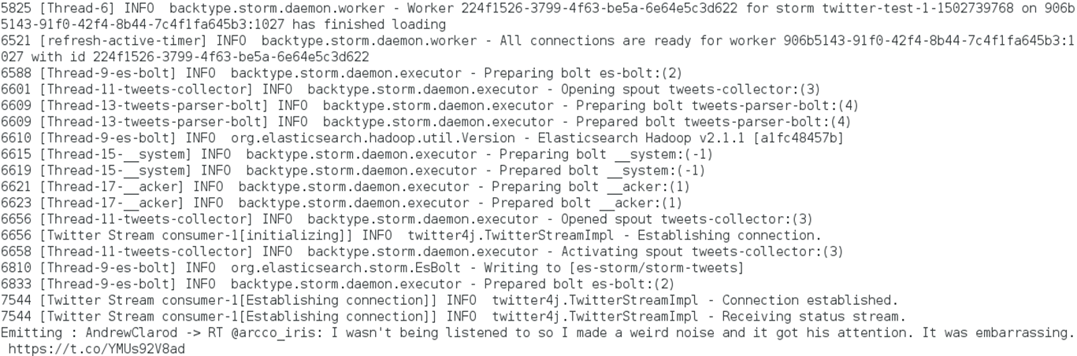
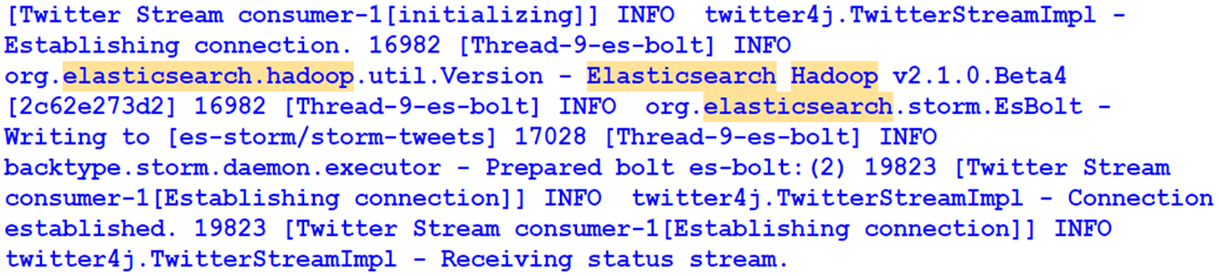
.
$ storm jar ch05-0.0.1-job.jar com.packetpub.esh.streaming.Topology

Slide 14
.
Pig with Elasticsearch.
Consider a crime dataset and import it to HDFS.
$ hadoop fs -put crimes_dataset.csv /lib/crimes_dataset.csv
Download the ES-Hadoop Jar file and ensure that it is imported to HDFS and register it with Pig.
$ hadoop fs -put elasticsearch-hadoop-2.1.1.jar /lib/elasticsearch-hadoop- 2.1.1.jar
grunt> REGISTER hdfs://localhost:9000/lib/elasticsearch-hadoop-2.1.1.jar;
grunt> SOURCE = load '/ch07/crimes_dataset.csv' using PigStorage(',') as (id:chararray, caseNumber:chararray, date:datetime, block:chararray, iucr:chararray, primaryType:chararray, description:chararray, location:chararray, arrest:boolean, domestic:boolean, lat:double,lon:double);
grunt> TARGET = foreach SOURCE generate id, caseNumber, date, block, iucr, primaryType, description, location, arrest, domestic, TOTUPLE(lon, lat) AS geoLocation;

Slide 15
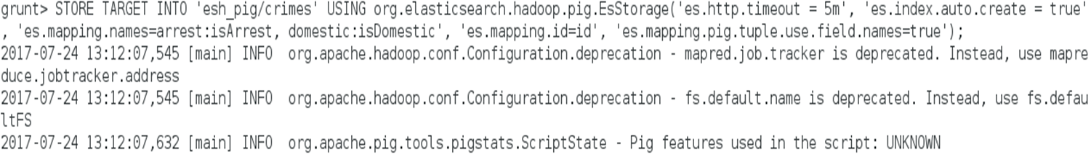
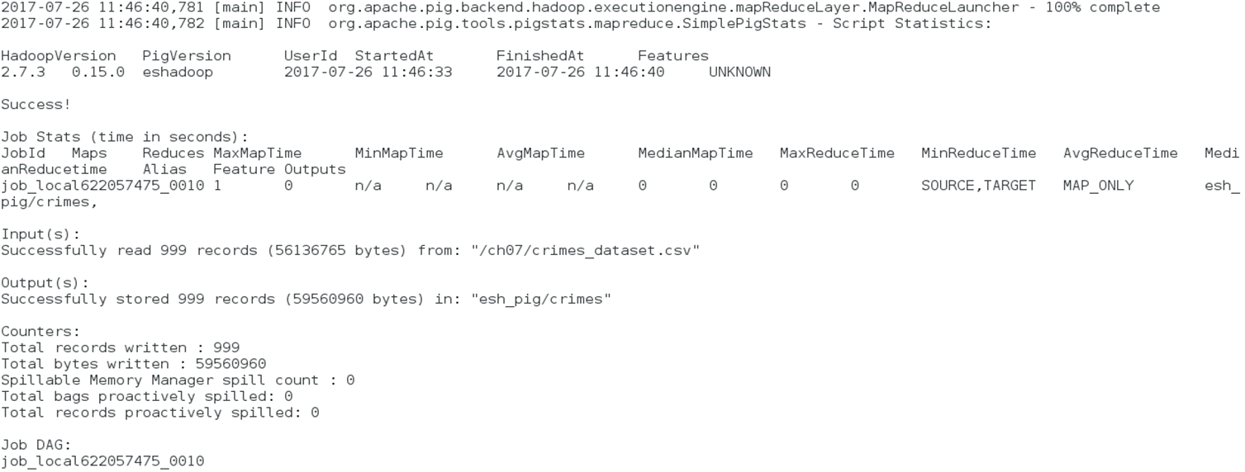
.
Now, the target is loaded into the Elasticsearch index.
The command will give us the results about the crime data documents pushed into Elasticsearch.

Slide 16
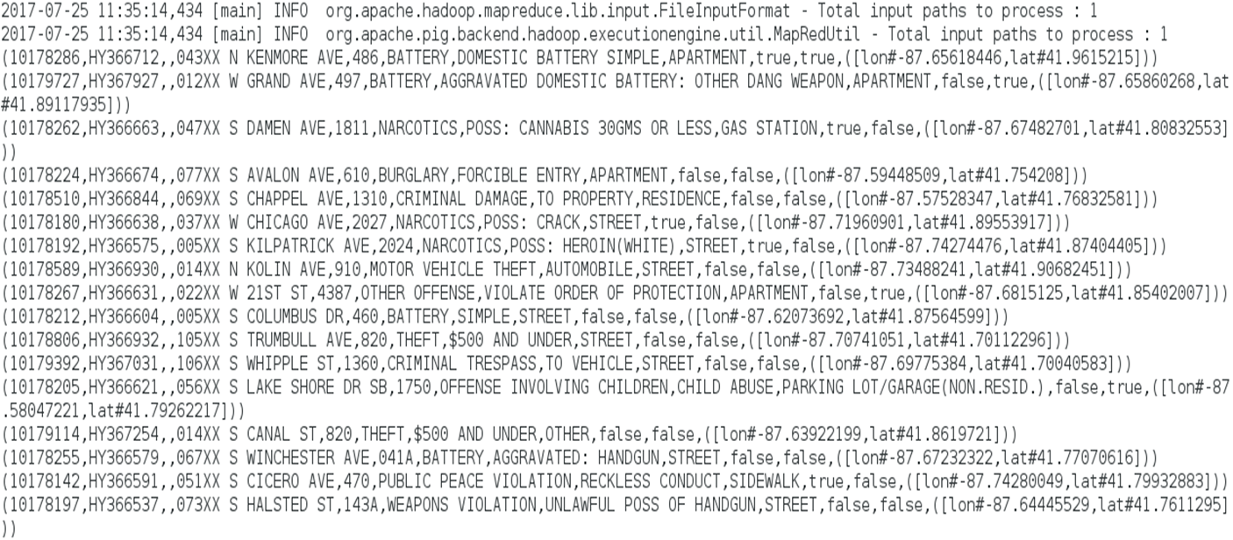
.
To read data from Elasticsearch through Pig, we can use the below queries:
The requested results are as follows:

Slide 17
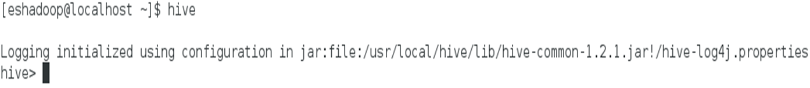
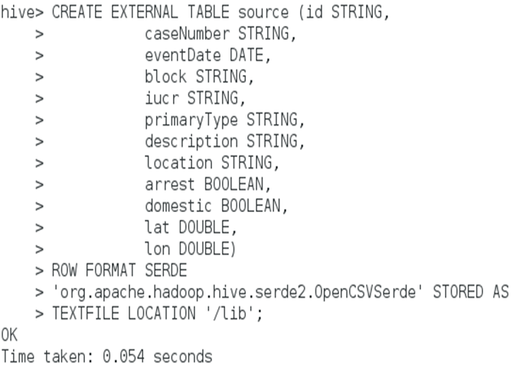
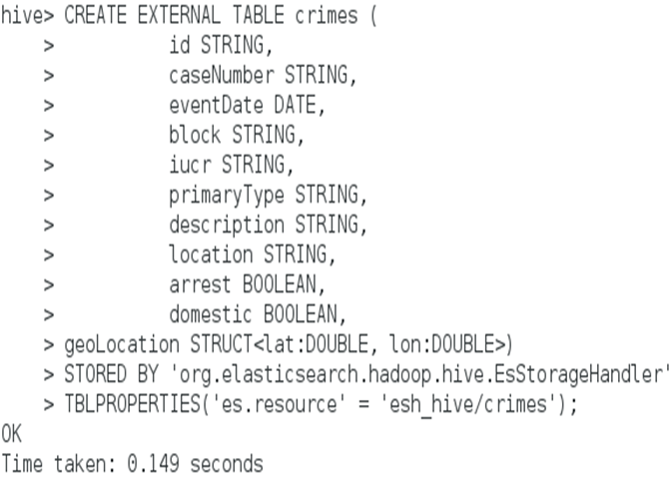
.
Elasticsearch with Hive using SQL.
Hive provides a SQL interface to the data in Hadoop Ecosystem. Hive is a data warehouse that provides data summarization, query and analysis.
Importing data to Elasticsearch in Hive is initiated by creating an external table and create a target table for crimes that point to Elasticsearch index.

Slide 18
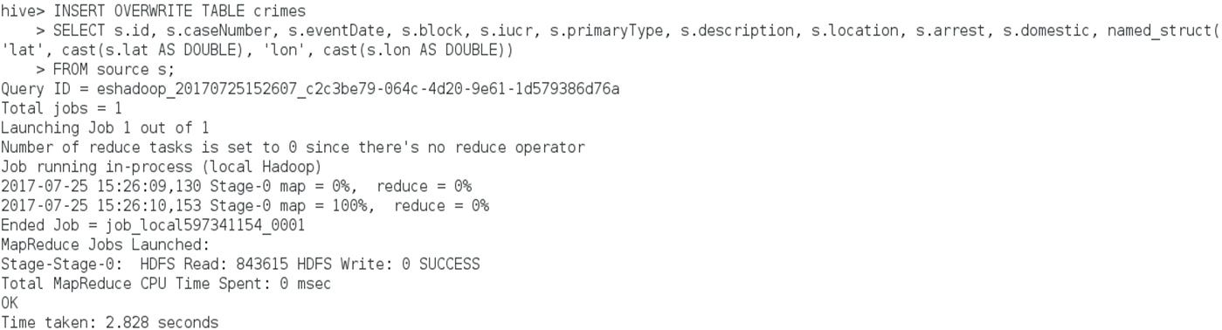
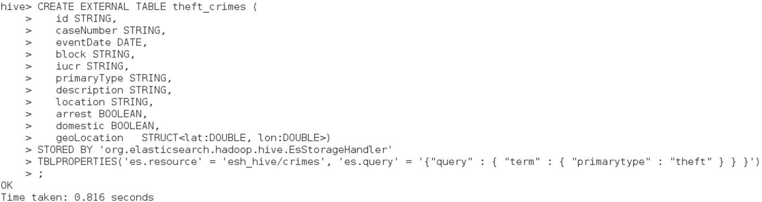
.
Now collect all the data from source table and insert into the crimes table using the below command:
Let’s see how to read the data from Elasticsearch through Hive. If we want to retrieve all theft crime documents, we first create a hive table:

Slide 19
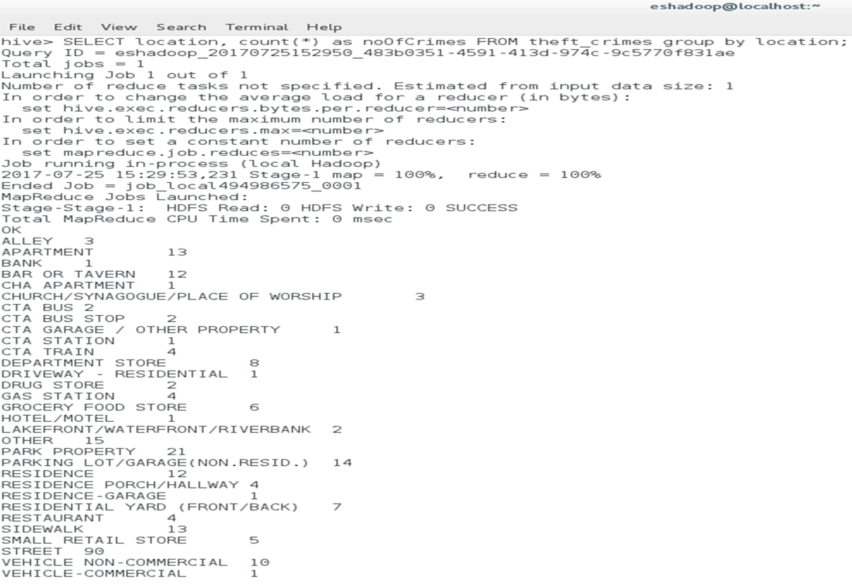
.
We can write SQL queries to get the data from Elasticsearch.

Slide 20
Elasticsearch using AWS
In this section, we implemented Elasticsearch in AWS using its services.
The major difference in working on a local server and AWS is that, in the local machine we use Elasticsearch on multiple tools separately and we need to start up each service every time we want to use Elasticsearch. And it is a tough job to run real time analytics on a local system as a user. If we have the log data already with us then the analysis would be simple and easy here.
Coming to AWS, it provides all the built-in tools that are required for us to work. It provides an interface where streaming, analytics, Elasticsearch and Kibana can be accessed from the same place. AWS gives a cloud environment with data storage buckets and services to stream real-time data. We should write a code in any programming language to stream the logs to AWS and perform analytics and visualizations on the streamed data. AWS provides the top infrastructure for streaming real time data.

Slide 21
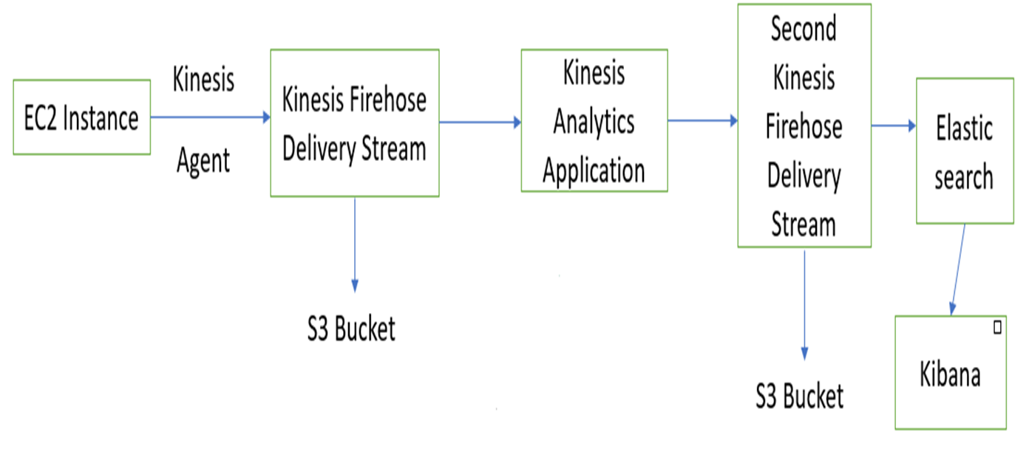
.
Architecture.

Slide 22
.
Demo

Slide 23
Conclusion
This project covers a broad spectrum of what Elasticsearch is and how it works on data search. How Elasticsearch is implemented to work with Hadoop and Kibana is clearly explained in this research.
Elasticsearch authorizes a quick insight of the data, which is in any form in the Hadoop Ecosystem.
We worked on diverse types of data in separate ways to see how Elasticsearch can be implemented and used on different tools like Apache Storm, Pig and Hive.
Also AWS, a dominant public cloud platform is used to implement Elasticsearch and provide a powerful and comprehensive infrastructure for data analytic applications.
It turned out well and we were successfully able to experiment and learn about all the above-mentioned instances on a CentOS 7 server and on AWS.

Slide 24
Future Work
This project can be considered as an initial step to learn about the combination of data analysis, Elasticsearch, Kibana, Hadoop and AWS.
Here we implemented all these services and built a data analytics solution which streams real-time data.
This project can be taken to the next level by performing multiple analytics, using various other strong tools and services that are available. Anomaly detection and trend analysis can be performed on the streaming data.
We can also enlarge data warehouses by adding full-text search and data discovery.
More advanced tools like Apache Kafka can be used to implement the Elasticsearch mechanisms and analyze real-time data in a more profound way.
Elasticsearch can also be ingested to detect cybercrimes from the log actions and take preventive measures to eradicate them.

Slide 25
Thank you!! Questions??

